Slide 1

Exploring the Use of Chomsky Normal Form in the Development of Efficient Parsing Algorithms
Chomsky Normal Form (CNF) is a powerful tool for simplifying the analysis of context-free grammars. It has proven crucial in designing and optimizing parsing algorithms.
R.JAHNAVI(192210575)
K.S.RAKSHITHA(192210582)

Slide 2
ABSTRACT
The application of Chomsky Normal Form (CNF) in the development of efficient parsing algorithms, essential for computer science, linguistics, and artificial intelligence.
CNF, a simplification of context-free grammars, facilitates more efficient parsing techniques, such as the CYK algorithm, which offers polynomial-time complexity for certain types of grammars.
The objective of this presentation is to thoroughly explore the use of Chomsky Normal Form (CNF) in the development of efficient parsing algorithms, aiming to enhance understanding of its significance in computational linguistics and algorithm design.
CNF is a specific type of context-free grammar where every production rule adheres to a standardized format, which simplifies the parsing process. Understanding CNF is crucial for developing algorithms that efficiently analyse and process language structures.
The transformation of grammars into CNF involves systematic procedures that ensure all rules conform to the CNF format. This process can enhance the clarity and manageability of grammars, making them easier to parse.
In CNF, parsing can be done more efficiently using algorithms such as the CYK algorithm or Earley's algorithm.

Slide 3
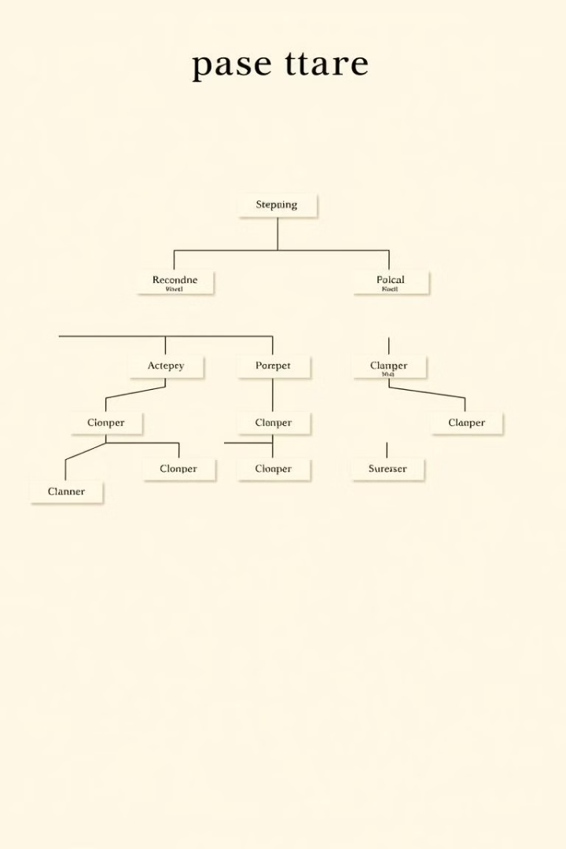
PARSE TREE
Fundamentals of Context-Free Grammars
Context-free grammars (CFGs) are a fundamental concept in formal language theory. They are used to define the syntax of programming languages and natural languages.
1
Production Rules
2
Non-Terminal Symbols
CFGs consist of production rules that specify how to generate strings in a language.
Non-terminal symbols represent grammatical categories, such as noun phrase or verb phrase.
3
Terminal Symbols
4
Derivation Process
Terminal symbols are the actual words or characters that make up the language.
The derivation process involves applying production rules to a starting symbol to produce a string in the language.

Slide 4
Advantages of Chomsky Normal Form
CNF is a restricted form of CFG where each production rule has a non-terminal on the left-hand side and either two non-terminals or a single terminal on the right-hand side.
Efficient Parsing
Simplified Analysis
Wide Applicability
CNF enables the development of efficient parsing algorithms, which are essential for understanding the structure of sentences.
By simplifying the structure of CFGs, CNF makes it easier to analyze and understand the language defined by the grammar.
CNF has applications in diverse fields, including natural language processing, compiler design, and artificial intelligence.

Slide 5
Conversion to Chomsky Normal Form
Any CFG can be converted to CNF using a series of well-defined transformations. This conversion process ensures that the original language is preserved.
1
Eliminate Epsilon Productions
Epsilon productions are productions that have an empty string on the right-hand side.
2
Eliminate Unit Productions
Unit productions are productions that have a single non-terminal on the right-hand side.
3
Introduce New Non-Terminals
New non-terminals are introduced to represent combinations of terminals and non-terminals.
4
Convert Remaining Productions
The remaining productions are converted to the standard CNF format.

Slide 6
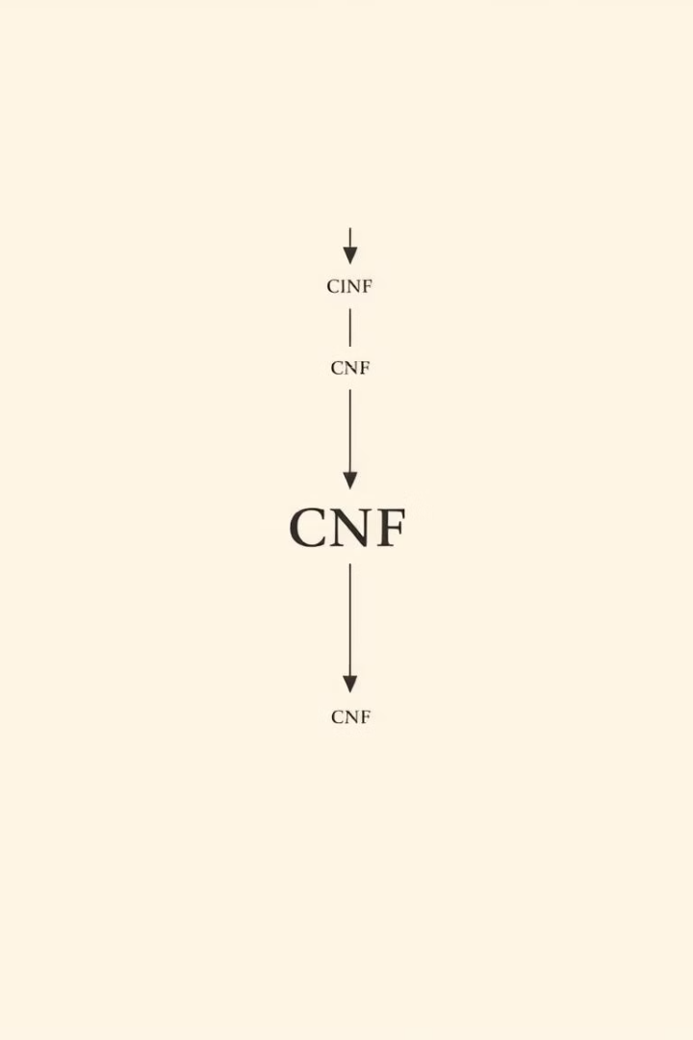



Parsing Algorithms and Chomsky Normal Form
CNF is a crucial factor in the design of efficient parsing algorithms. It simplifies the process of analyzing and understanding the structure of sentences.
Bottom-Up Parsing
Bottom-up parsing algorithms work by starting from the terminals and building up the parse tree.
Top-Down Parsing
Top-down parsing algorithms start from the start symbol and expand it to match the input string.
Chart Parsing
Chart parsing combines bottom-up and top-down approaches to efficiently parse sentences.

Slide 7
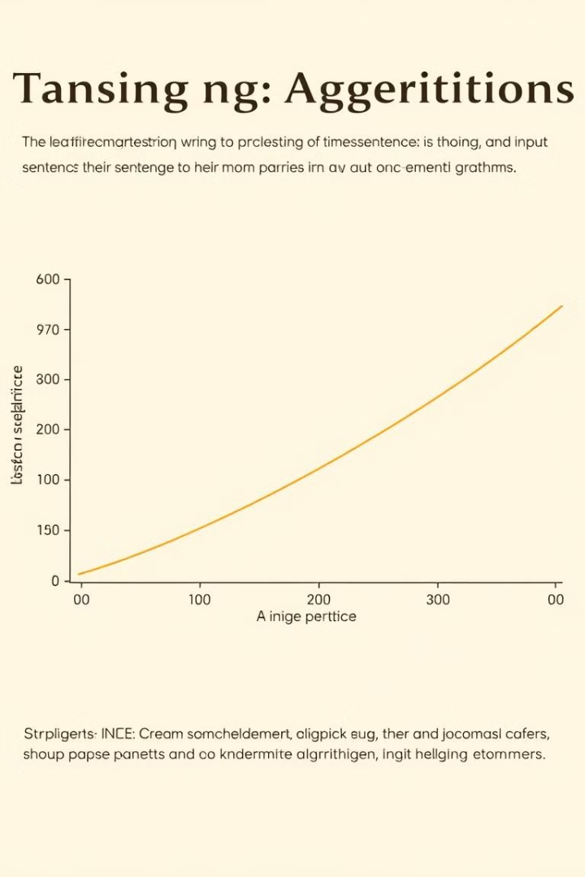
Time Complexity of Parsing Algorithms
Parsing algorithms in CNF typically have a time complexity of O(n^3), where n is the length of the input sentence.
Algorithm
Time Complexity
CYK Algorithm
O(n^3)
Earley Algorithm
O(n^3)

Slide 8
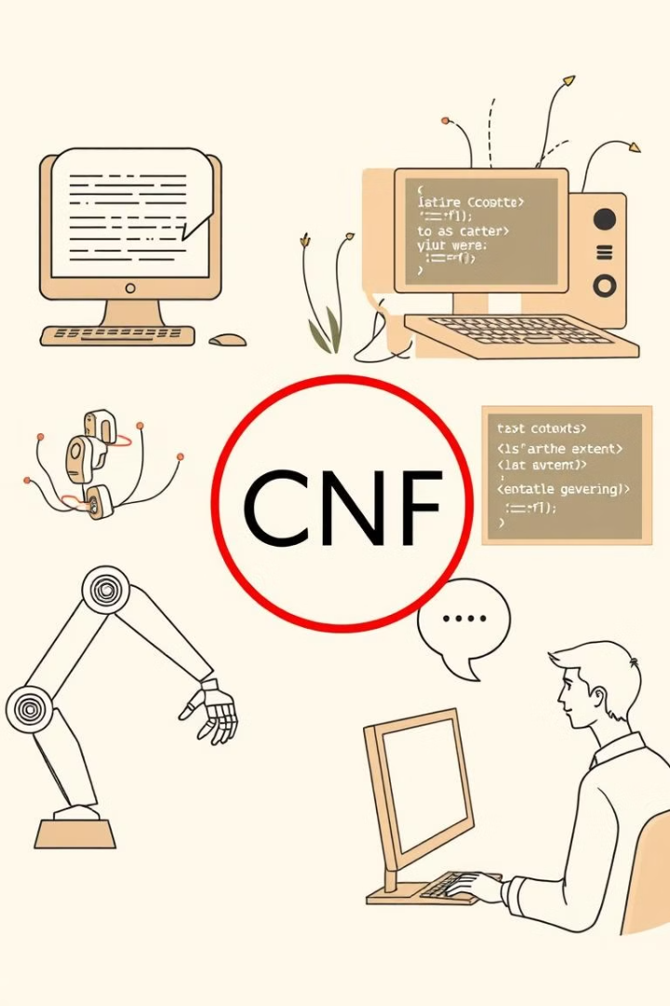




Applications of Chomsky Normal Form
CNF has numerous applications across different areas of computer science and linguistics.
Natural Language Processing
Compiler Design
CNF is used in natural language processing systems to analyze and understand human language.
Compilers use CNF to parse source code and generate executable programs.
Artificial Intelligence
Computational Linguistics
CNF plays a role in artificial intelligence systems, enabling them to process and understand language.
Computational linguistics researchers use CNF to study and model human language.

Slide 9

Conclusion and Future Directions
CNF has proven to be a powerful tool for designing efficient parsing algorithms and simplifying the analysis of CFGs.
Further Optimization
New Applications
Advancements in CFGs
Researchers are continuously exploring ways to improve the efficiency of parsing algorithms in CNF.
CNF is finding applications in emerging fields such as machine learning and data mining.
New research areas in CFGs are exploring extensions and generalizations of CNF.

Slide 10


